Slide 1


ASP.NET Part – I & II
Md. Mahedee Hasan
Software Architect
Leadsoft Bangladesh Limited
Linkedin: http://www.linkedin.com/in/mahedee
Blog: http://mahedee.net/
http://mahedee.blogspot.com/

Slide 2
Contents
Part - I
Introduction to .NET Framework
Visual Studio.NET IDE
Web Architecture in ASP.net
Software Architecture Basics
ASP.net Control
HTML Control
ASP.net Provider model
ASP.net Membership Provider model
Master Page/Content Page
ASP.net Themes

Slide 3
Contents…
Part - II
ASP.NET Compilation
Website configuration
State Management
Caching
Global Application Class (Global.asax)
Culture (Localization and globalization)
ASP.net Grid view
Introduction to IIS
ASP.net Page Lifecycle
ASP.net website deployment in IIS
Notes:
Extra Topic: Global Application Class (Global.asax),ASP.net web service, Crystal report and ASP.net

Slide 4
Part - I
Notes:
Extra Topic: Global Application Class (Global.asax),ASP.net web service, Crystal report and ASP.net

Slide 5
Introduction to .NET Framework
What is Microsoft .NET?
  Another Programming Language?
  No, then what it is?
  A framework that supports
    Programming Languages:
      e.g. C#, Visual Basic, C++, J# e.t.c
    Data, Markup Laguages:
      e.g. HTML, XML, CS
  A Software Platform.
  Language neutral.
  In general
    Framework is a basic or essential supporting structure of a system, concept or text.

Slide 6
Introduction to .NET Framework…
.NET framework is for developing web-based and windows-based applications within the Microsoft environment.
ASP.NET is the part of Microsoft .NET framework.
Framework Class Library was designed to make it easier to perform the most common programming tasks.
    Example: File class, Graphics class, Random class, SmtpClient class e.t.c

Slide 7
Introduction to .NET Framework …
Narrow view of .NET Application
.NET Application
.NET Framework
Operating System + Hardware

Slide 8
Introduction to .NET Framework …
.NET Technical Architecture
Visual Studio.NET
VB
VC++
VC#
JScript
…
Common Language Specification
ASP.NET: Web Services
and Web Forms
Windows
Forms
ADO.NET: Data and XML
Base Class Library
Common Language Runtime
Notes:
The .NET framework exposes numerous classes to the developer. These classes allow the development of rich client applications and Web based applications alike. In the above slide these classes have been divided into 4 areas. ASP.NET provides the core Web infrastructure such as Web Forms for UI based development and Web Services for programmatic interface development, User interface development on the Windows platform can be done using Windows Forms ADO.NET and XML provide the functionality for data access. Finally, the core base classes provide infrastructure services such as security, transaction management etc.

Slide 9
Introduction to .NET Framework …
Compilation in .NET
Code in VB.NET
Code in C#
Code in another
.NET Language
VB.NET compiler
C# compiler
Appropriate
Compiler
IL(Intermediate
Language) code
CLR just-in-time
execution
Notes:
The .NET framework exposes numerous classes to the developer. These classes allow the development of rich client applications and Web based applications alike. In the above slide these classes have been divided into 4 areas.
ASP.NET provides the core Web infrastructure such as Web Forms for UI based development and Web Services for programmatic interface development,
User interface development on the Windows platform can be done using Windows Forms
ADO.NET and XML provide the functionality for data access.
Finally, the core base classes provide infrastructure services such as security, transaction management etc.

Slide 10
Introduction to .NET Framework …
CLR Execution Model
Source code
VB
C#
C++
Compiler
Compiler
Compiler
Unmanaged
Component
Managed
code
Assembly
IL Code
Assembly
IL Code
Assembly
IL Code
Common Language Runtime
JIT Compiler
Native Code
Operating System Services
Notes:
The code, which is developed outside .NET, Framework is known as unmanaged code.
Applications that do not run under the control of the CLR are said to be unmanaged, and certain languages such as C++ can be used to write such applications, which, for example, access low - level functions of the operating system. Background compatibility with code of VB, ASP and COM are examples of unmanaged code.

Slide 11
Introduction to .NET Framework …
Inspection : Compilation in .NET
  The source code get compiled by its own Compiler. As C# gets compiled by the c# compiler.
  After the compilation the Intermediate Language Code is generated. Which is also known as MSIL [Microsoft Intermediate Language]. This code is understandable by the CLR.
  No matter in which language the code is written if the language is .net supported then CLR will start processing the Intermediate Language Code.
  JIT is a part of CLR which executes the assembly. Just in Time compiles the code to generate the machine Native Code, which will be processed by the OS.

Slide 12
Visual Studio.NET IDE
A powerful IDE
Rich visual interface
Support drag and drop
Single IDE for all languages
Server Explorer
  Event Viewer, Message Queues, Services
  SQL Databases, Data Connection, Etc.
Integrated IE Browser
Integrated D server
Debugging tool
Solution explorer

Slide 13
Visual Studio.NET IDE…
HTML/XML Editors
Dynamic Help
Common Forms Editor
  VB.NET, C++, and C#
Deployment facility
Beauty of .NET
  Less line of code required
  Require less time to develop
  Lower deployment costs

Slide 14
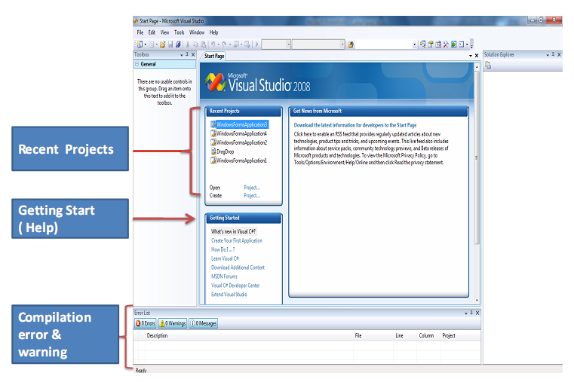
Visual Studio.NET IDE…
Visual Studio .NET Environment

Slide 15
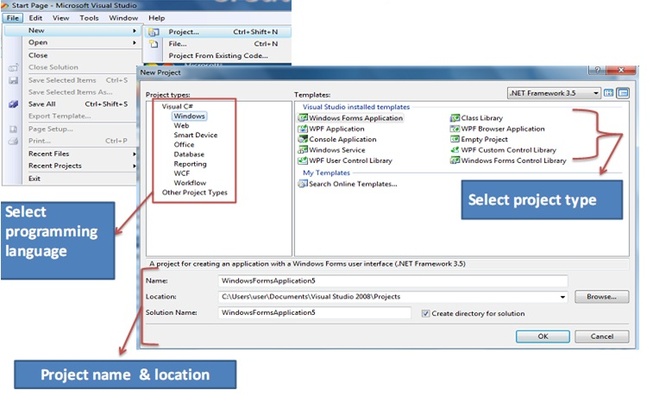
Visual Studio.NET IDE...
Create Project

Slide 16
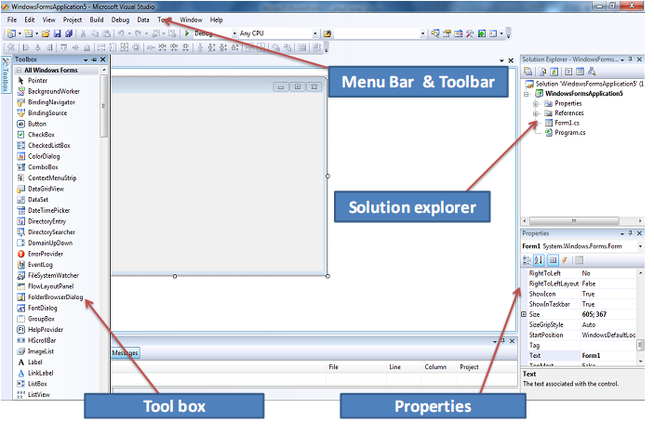
Visual Studio.NET IDE...
Environment : After creating project

Slide 17
ASP.net
Introduction
  ASP - Active Server Pages
  Introduced in 1998 as Microsoft's first server side scripting engine.
  ASP.NET is a new ASP generation.
  It is not compatible with Classic ASP, but may include Classic ASP.
  ASP.NET pages are compiled, which makes them faster than Classic ASP.
  ASP.NET pages have the extension .aspx, and are normally written in VB (Visual Basic) or C# (C sharp).

Slide 18
ASP.net …
ASP.NET, the platform services that allow to program Web Applications and Web Services in any .NET language
ASP.NET Uses .NET languages to generate HTML pages. HTML page is targeted to the capabilities of the requesting Browser
ASP.NET “Program” is compiled into a .NET class and cached the first time it is called. All subsequent calls use the cached version.

Slide 19
ASP.net …
Logical Evolution of ASP
  Supports multiple languages
  Improved performance
  Control-based, event-driven execution model
  More productive
  Cleanly encapsulated functionality

Slide 20
ASP.net …
ASP.net Web form
  Allows clean cut code
      Code-behind Web Forms
  Easier and rich tool
  Code within is compiled then executed
  Improved handling of state information
  Support for ASP.NET server controls
      Data validation
      Data bound grids

Slide 21
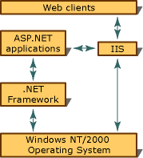
Web Architecture in ASP.net

Slide 22
Web Architecture in ASP.net …
The web application gets hosted in the server. The web client accepts the request and transmits it to the IIS using the HTTP Protocol.
HTTP is a transfer protocol for hyper text which is responsible for the transmission of request and reply. It uses actions like Get/Put and different Status Codes while transmission. It carries the request to the target server and also traverse back with the reply. Depending on the action and status code the client and server communicates.
In the server side IIS accepts the request and process the request. IIS checks for the resource and if it is a .net resource then IIS asks the .net framework to process the request.
Once the resource is ready then it is transferred to IIS again and using the HTTP the reply is sent to the client as it uses the HTTP channel so the reply has the content in hyper text.
Notes:
HTTP is a simple request-response protocol that normally runs over TCP. It is also possible to pipeline requests, that is, send request 2
Before the response to request 1 has arrived.

Slide 23
Software Architecture Basics
Software Architecture is the structure of the solution that meets
  All of the technical and operational requirements
  Optimizing quality attributes
    Performance
    Security
  Increase manageability
Notes:
Software application architecture is the process of defining a structured solution that meets all of the technical and operational requirements, while optimizing common quality attributes such as performance, security, and manageability. It involves a series of decisions based on a wide range of factors, and each of these decisions can have considerable impact on the quality, performance, maintainability, and overall success of the application.

Slide 24
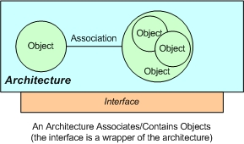
Software Architecture Basics …
Software architecture is
  A blue print of system and project
  The primary carrier of the system quality
  An artifact for early analysis to make sure that the design approach will yield an acceptable system.
  In short, architecture is the conceptual glue that holds every phase of the project together for all its many stakeholders.
  Manages a collection of discrete objects
  Implements a set of specific design elements
Notes:
Software application architecture is the process of defining a structured solution that meets all of the technical and operational requirements, while optimizing common quality attributes such as performance, security, and manageability. It involves a series of decisions based on a wide range of factors, and each of these decisions can have considerable impact on the quality, performance, maintainability, and overall success of the application.

Slide 25
Software Architecture Basics…
Layer vs. Tier
Layer
  Logical structure of the application
  Typically layer is the logical organization of the code
  It cannot deploy as different process or different server
  Ex. Presentation, business and data layer
Tier
  Physical structure of the application
  It is said that tier is the physical deployment of the layer
  It can deploy as different process or different server
  Ex. Presentation, business and data tier
Notes:
Software application architecture is the process of defining a structured solution that meets all of the technical and operational requirements, while optimizing common quality attributes such as performance, security, and manageability. It involves a series of decisions based on a wide range of factors, and each of these decisions can have considerable impact on the quality, performance, maintainability, and overall success of the application.

Slide 26
ASP.net Control
AdRotator Displays a sequence of images
Button Displays a push button
Calendar Displays a calendar
CalendarDay A day in a calendar control
CheckBox Displays a check box
DropDownList Creates a drop-down list
HyperLink Creates a hyperlink
Label Displays static content which is programmable
LinkButton Creates a hyperlink button
ListBox Creates a single- or multi-selection drop-down list
Notes:
Software application architecture is the process of defining a structured solution that meets all of the technical and operational requirements, while optimizing common quality attributes such as performance, security, and manageability. It involves a series of decisions based on a wide range of factors, and each of these decisions can have considerable impact on the quality, performance, maintainability, and overall success of the application.

Slide 27
ASP.net Control…
Panel Provides a container for other controls
PlaceHolder Reserves space for controls added by code
RadioButton Creates a radio button
RadioButtonList Creates a group of radio buttons
Table Creates a table
TableCell Creates a table cell
TableRow Creates a table row
TextBox Creates a text box
Notes:
Software application architecture is the process of defining a structured solution that meets all of the technical and operational requirements, while optimizing common quality attributes such as performance, security, and manageability. It involves a series of decisions based on a wide range of factors, and each of these decisions can have considerable impact on the quality, performance, maintainability, and overall success of the application.

Slide 28
ASP.net Control…
CompareValidator Compares the value of one input control to the value of another input control or to a fixed value
CustomValidator Allows you to write a method to handle the validation of the value entered
RangeValidator Checks that the user enters a value that falls between two values
RequiredFieldValidator Makes an input control a required field
ValidationSummary Displays a report of all validation errors occurred in a Web page
RegularExpressionValidator Ensures that the value of an input control matches a specified pattern
Notes:
Software application architecture is the process of defining a structured solution that meets all of the technical and operational requirements, while optimizing common quality attributes such as performance, security, and manageability. It involves a series of decisions based on a wide range of factors, and each of these decisions can have considerable impact on the quality, performance, maintainability, and overall success of the application.

Slide 29
HTML Control…
HtmlButton Controls a <button> HTML element
HtmlForm Controls a <form> HTML element
HtmlInputHidden Controls an <input type="hidden"> HTML element
HtmlTable Controls a <table> HTML element
HtmlTableCell Controls <td>and <th> HTML elements
HtmlTableRow Controls a <tr> HTML element
HtmlTextArea Controls a <textarea> HTML element
Notes:
Software application architecture is the process of defining a structured solution that meets all of the technical and operational requirements, while optimizing common quality attributes such as performance, security, and manageability. It involves a series of decisions based on a wide range of factors, and each of these decisions can have considerable impact on the quality, performance, maintainability, and overall success of the application.

Slide 30
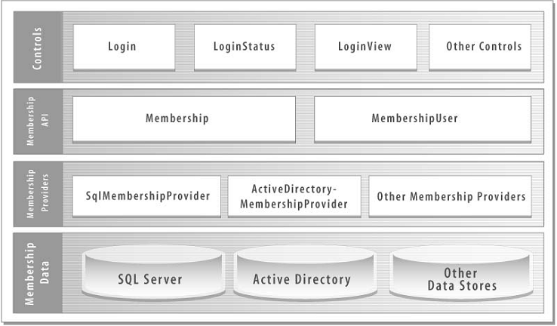
ASP.net Provider Model
A provider is a software module that provides a uniform interface between a service and a data source.
To make ASP.net state storage both flexible and extensible
The membership provider model

Slide 31
ASP.net Provider Model…
Membership
    System.Web.Security.ActiveDirectoryMembershipProvider
    System.Web.Security.SqlMembershipProvider
Role management
    System.Web.Security.AuthorizationStoreRoleProvider
    System.Web.Security.SqlRoleProvider
    System.Web.Security.WindowsTokenRoleProvider
Site map
    System.Web.XmlSiteMapProvider
Profile
    System.Web.Profile.SqlProfileProvider
Notes:
In any application, if you want to store the user information other than the Registration details like their address, user's interest, themes, etc., you can use the SqlProfileProvider.

Slide 32
ASP.net Provider Model…
Session state
    System.Web.SessionState.InProcSessionStateStore
    System.Web.SessionState.OutOfProcSessionStateStore
    System.Web.SessionState.SqlSessionStateStore
Web events
    System.Web.Management.EventLogWebEventProvider
    System.Web.Management.SimpleMailWebEventProvider
    System.Web.Management.TemplatedMailWebEventProvider
    System.Web.Management.SqlWebEventProvider
    System.Web.Management.TraceWebEventProvider
    System.Web.Management.WmiWebEventProvider

Slide 33
ASP.net Provider Model…
Web Parts personalization
      System.Web.UI.WebControls.WebParts.SqlPersonalizationProvider
Protected configuration
      System.Configuration.DPAPIProtectedConfigurationProvider
      System.Configuration.RSAProtectedConfigurationProvider

Slide 34
Master Page/ Content Page
Master Page
A Master page defines the site-wise layout and the regions editable on a content page-by-content page basis.
Firstly introduce in ASP.NET 2.0 on VS 2005. And in VS 2008 offers design-time support for nested master pages.
Special @Master directive
  <%@ Master Language="C#" CodeFile="MasterPage.master.cs" Inherits="MasterPage" %>

Slide 35
Master Page/ Content Page
Content Page
With the master page created, we are ready to start creating ASP.NET pages that are bound to the master page. Such pages are referred to as content pages.
  <asp:contentplaceholder id="Main" runat="server" />

Slide 36
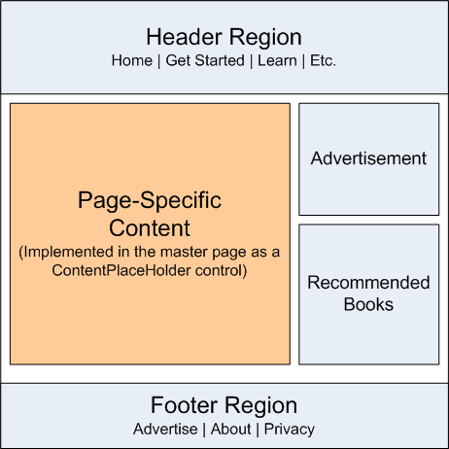
Master Page/ Content Page
Fig – Sample Master Page

Slide 37
ASP.net Themes
Themes is a cool and easy way to create a consistent look and feel across a page or an entire website
By using themes, you can easily customize your server controls with predefined looks
The themes feature allows to dictate the appearance of controls in your application using template files with a .skin extension, and with style sheets
A .skin file can contain one or more control skins for one or more control types.

Slide 38
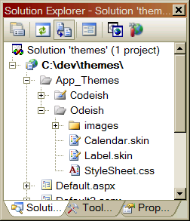
ASP.net Themes …

Slide 39
ASP.net Themes …
The most important types of files in a Theme folder are the following:
  Skin files
  Cascading Style Sheet file

Slide 40
ASP.net Themes …
Adding Skins to theme (Default)
  You must always include a Runat attribute, but you can never include the ID attribute when declaring a control in a Skin
<asp:TextBox BackColor=”Yellow” BorderStyle=”Dotted” Runat=”Server” />
<%@ Page Title="" Language="C#" MasterPageFile="~/Site.master" AutoEventWireup="true" CodeFile="Default.aspx.cs" Inherits="_Default" Theme="Textbox" %>

Slide 41
ASP.net Themes …
Named skin
  When you create a Named Skin, you can decide when you want to apply the Skin.
  <asp:TextBox SkinID=“DashedTextBox” BorderStyle=“Dashed” BorderWidth=“5px” Runat=“Server” />
  <%@ Page Language=”C#” Theme=”Textbox” %>
  <asp:TextBox id=“txtFirstName” SkinID=“DashedTextBox” Runat=“server” />

Slide 42
ASP.net Themes …
Themes Versus StyleSheetThemes
  You might want to display every Label in your web site with an orange back-
  Ground color except for one Label. In that case, it would be nice if there was a way to override the Skin property.
  <asp:Label BackColor=”Orange” Runat=”Server” />
  <%@ Page Language=”C#” StyleSheetTheme=”Labelskin” %>
  <asp:Label id=”Label1” Text=”What color background do I have?” BackColor=”red” Runat=”server” /

Slide 43
ASP.net Themes …
Disabling Themes
  <asp:Calendar id=”Calendar2” EnableTheming=”false” Runat=”server” />
  Adding Cascading Style Sheets to Themes
    h1 {
    color: red;
    background-color:gray;
    }
    <h1>.:Cascading Style Sheet as a theme:.</h1>

Slide 44
Part - II
Notes:
Extra Topic: Global Application Class (Global.asax),ASP.net web service, Crystal report and ASP.net

Slide 45
ASP.net Compilation
ASP.net first compiles the code into one or more assemblies in order to service request by the user.
ASP.net code can be write in many different languages – C#, Visual basic, J#, others.
Code is compiled to MSIL
  MSIL is language and CPU independent
At run time, MSIL runs in the context of the .NET Framework, which translates MSIL into CPU-specific instructions for the processor
Notes:
MSIL – Microsoft intermediate language

Slide 46
ASP.net Compilation…
Benefits of compiling application code
  Performance
    Compiled code is much faster than scripting code
  Security
    Compiled code is difficult to reverse engineering
  Stability
    Code is checked at compile time for syntax errors, type safety, and other problems
  Interoperability
    MSIL code is supported by .NET, you can use assemblies that were originally written in other languages in your code
Notes:
Compiled code is much faster than scripting languages such as ECMAScript or VBScript because it is a closer representation to machine code and does not require additional parsing.

Slide 47
ASP.net Compilation…
ASP.net compilation architecture features
  Multiple language supports
  Automatic compilation
    ASP.NET automatically compiles your application code and any dependent resources the first time a user requests a resource from the Web site
  Flexible deployment
    ASP.NET compiler tool (ASPNET_Compiler.exe) provides the following pre compilation options:
      In place compilation
      Non-updateable full pre compilation
      Updateable pre compilation
  Extensible build system
    Extend and customize the ASP.NET build system to compile custom resources by creating classes that inherit from the BuildProvider class
Notes:
In place compilation means on demand compilation, No-updatable means not updatable, updatable pre compilation – Example: partially release

Slide 48
ASP.net Compilation…
Dynamic compilation
  ASP.NET dynamic compilation enables you to modify your source code without having to explicitly compile your code before you deploy your Web application
  Compiling on first request
  Recompiling on change
  Compilation dependencies
  Compilation output
    Compilation folder output
      %SystemRoot%\Microsoft.NET\Framework\versionNumber\Temporary ASP.NET Files
    Compilation Folder Required Permissions
    Compilation Folder Configurability
      %FrameworkInstallLocation%\Temporary ASP.NET Files
  Support multiple languages

Slide 49
ASP.net Compilation…
Disadvantages of dynamic compilation
  Slower
    Pages and code files must be compiled the first time they are requested
  Dynamic compilation does not offer a means to identify compile-time bugs
  Does not provide the ability to create a compiled version

Slide 50
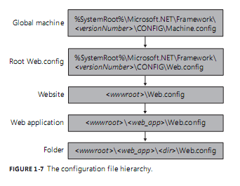
Website configuration
ASP.net uses a hierarchical system of configuration
At the top of the hierarchy is Machine.config file
  C:\WINDOWS\Microsoft.NET\Framework\v2.0.50727\CONFIG\Machine.config

Slide 51
Website configuration…
The \CONFIG folder includes the following six files:
  Machine.config—Contains the actual configuration settings.
  Machine.config.default—Contains the default values for all configuration settings.
  Machine.config.comments—Contains comments on each configuration setting.
  Web.config—Contains the actual configuration settings.
  Web.config.default—Contains the default values for all configuration settings.
  Web.config.comments—Contains comments on each configuration setting

Slide 52
Website configuration…
Web.config file and it’s elements
ASP.NET Web.config file provides you a flexible way to handle all your requirements at the application level
Web.config files are stored in XML format which makes us easier to work with
IIS is configured in such a way that it prevents the Web.config file access from the browser.
The changes in Web.config don’t require the reboot of the web server.

Slide 53
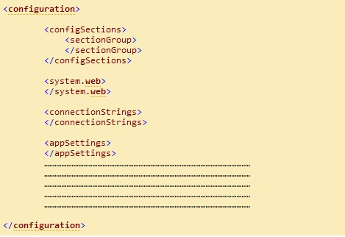
Website configuration…
Hierarchy of the Web.config file

Slide 54
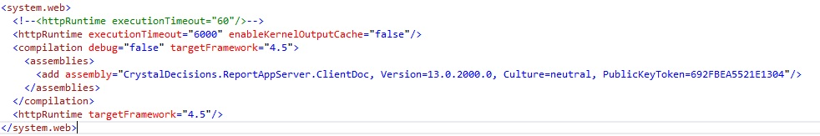

Website configuration…
Elements of Web.config file

Slide 55


Website configuration…
Elements of Web.config file
Connection string settings
App Settings
Session State Settings

Slide 56
Website configuration…
Programmatically accessing web.config file
Reading appSettings values
  string key = ConfigurationManager.AppSettings["AppKey"];
Reading connectionstring values
  string cnn = ConfigurationManager.ConnectionStrings["conn"].ConnectionString;
Update the configuration section values
  Configuration config = WebConfigurationManager.OpenWebConfiguration("~/");
  //Get the required section of the web.config file by using configuration object.
  CompilationSection compilation =
  (CompilationSection)config.GetSection("system.web/compilation");
  //Update the new values.
  compilation.Debug = true;
  config.Save();

Slide 57
State Management
The State or Cache Management is nothing but the way to storing the data in Client-Side and in Server-Side using small memory.
There are two ways to manage state:
  Client Side State management
    Stores information on the client's computer
  Server side state management
    Store information on application server
    Higher security than client-side options
    Used more web server resources

Slide 58
State Management…
Client side state management
  View State
  Hidden fields
  Cookies
  Query Strings
  Control State
Server side state management
  Application state
  Session state

Slide 59
State Management…
View state
  It stores data in the generated HTML using hidden field not on the server.
  View State provides page level state management
  As long as the user is on the current page, state is available and the user redirects to the next page and the current page state is lost
  View State can store any type of data because it is object type but it is preferable not to store a complex type of data due to the need for serialization and deserialization on each post back

Slide 60
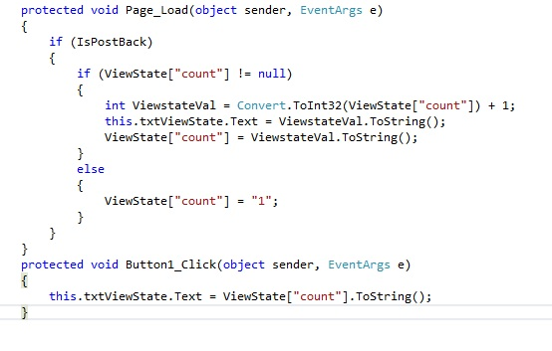
State Management…
View state…

Slide 61
State Management…
Hidden Fields
Hidden fields are used to store data at the page level
Hidden fields are not rendered by the browser.
It's just like a standard control for which you can set its properties
Advantages:
  Simple to implement for a page specific data
  Can store small amount of data so they take less size.
Disadvantages:
  Inappropriate for sensitive data
  Hidden field values can be intercepted(clearly visible) when passed over a network

Slide 62
State Management…
Hidden Fields…
  <asp:HiddenField ID="HiddenField1" runat="server" />
  protected void Page_Load(object sender, EventArgs e)
  {
  if (HiddenField1.Value != null)
  {
  int val= Convert.ToInt32(HiddenField1.Value) + 1;
  HiddenField1.Value = val.ToString();
  Label1.Text = val.ToString();
  }
  }
  protected void Button1_Click(object sender, EventArgs e)
  {
  }

Slide 63
State Management…
Cookies
A cookie is a small piece of text stored on user's computer
Every time a user visits a website, cookies are retrieved from user machine and help identify the user
Advantages:
  Simplicity
Disadvantages:
  Cookies can be disabled on user browsers
  Cookies are transmitted for each HTTP request/response causing overhead on bandwidth
  Inappropriate for sensitive data

Slide 64
State Management…
Cookies..
Persistence Cookie: Cookies which you can set an expiry date time are called persistence cookies. Persistence cookies are permanently stored till the time you set.
  Response.Cookies["nameWithPCookies"].Value = "This is A Persistance Cookie";
  Response.Cookies["nameWithPCookies"].Expires = DateTime.Now.AddSeconds(10);
  And the second one is:
  HttpCookie aCookieValPer = new HttpCookie("Persistance");
  aCookieValPer.Value = "This is A Persistance Cookie";
  aCookieValPer.Expires = DateTime.Now.AddSeconds(10);
  Response.Cookies.Add(aCookieValPer);

Slide 65
State Management…
Cookies…
Non-Persistence Cookie: Non persistence cookies are not permanently stored on the user client hard disk folder. It maintains user information as long as the user accesses the same browser. When user closes the browser the cookie will be discarded.
  Response.Cookies["nameWithNPCookies"].Value = "This is A Non Persistance Cookie";
  And the second way is:
  HttpCookie aCookieValNonPer = new HttpCookie("NonPersistance");
  aCookieValNonPer.Value = "This is A Non Persistance Cookie”; Response.Cookies.Add(aCookieValNonPer);
  How to read a cookie:
  if (Request.Cookies["NonPersistance"] != null)
  Label2.Text = Request.Cookies["NonPersistance"].Value;

Slide 66
State Management…
QueryString
Query strings are usually used to send information from one page to another page.
They are passed along with URL in clear text.
Advantages:
  Simple to Implement
Disadvantages:
  Human Readable
  Client browser limit on URL length
  Cross paging functionality makes it redundant
  Easily modified by end user
  http://www.productdetails.aspx?productid=4
  string v = Request.QueryString["productid"];

Slide 67
State Management…
Application State
Application object is used to store data which is visible across entire application
Shared across multiple user sessions.
Data which needs to be persisted for entire life of application should be stored in application object.
  Application.Lock();
  Application["mydata"]="mydata";
  Application.UnLock();

Slide 68
State Management…
Session Object
Session object is used to store state specific information per client basis.
It is specific to particular user.
Session data persists for the duration of user session you can store session's data on web server in different ways.
  Session[“userName"] = “mahedee”;//Set Value to The Session
  Label2.Text = Session[“userName"].ToString(); //Get Value from the Session

Slide 69
State Management…
Session State Mode
There are four session storage mechanisms provided by ASP.NET
  InProc mode
  StateServer mode
  SQLServer mode
  Custom mode
InProc Mode
  InProc mode is the default mode provided by ASP.NET
  In this mode, session values are stored in the web server's memory (in IIS).
  <sessionstate mode="InProc" cookieless="false" timeout="10“ />

Slide 70
State Management…
Session State Mode…
  StateServer mode
  This mode could store session in the web server but out of the application pool.
  Usually if this mode is used there will be a separate server for storing sessions, i.e., stateServer.
  The benefit is that when IIS restarts, the session is available.
  It stores session in a separate Windows service.
  For State server session mode, we have to configure it explicitly in the web config file and start the aspnet_state service.
    <sessionstate mode="stateserver" cookieless="false"
    timeout="10" stateConnectionString="tcpip=127.0.0.1:42424"/>

Slide 71
State Management…
Session State Mode…
  SQLServer mode
  Session is stored in a SQL Server database.
  This kind of session mode is also separate from IIS, i.e., session is available even after restarting the IIS server.
  This mode is highly secure and reliable but also has a disadvantage that there is overhead from serialization and deserialization of session data.
  This mode should be used when reliability is more important than performance.
  <sessionstate mode="sqlserver" cookieless="false" timeout="10"
  stateConnectionString="tcpip=127.0.0.1:4 2424"
  sqlConnectionString="Data Source=.\SqlDataSource;User ID=userid;Password=password"/>

Slide 72
State Management…
Session State Mode…
  Custom mode
    Generally we should prefer InProc state server mode or SQL Server mode
    If you need to store session data using other than these techniques then ASP.NET provides a custom session mode.
    This way we have to maintain everything customized even generating session ID, data store, and also security.

Slide 73
Caching
Caching is a technique of storing data in memory which takes time to create
There are two main types of caching:
  Output caching
    Cache the final render HTML of the page.
    When the same page is requested again, the cached page is served
    ASP.NET does not start the page life cycle and does not execute the code
    <%@ OutputCache Duration=”60” VaryByParam=”None”%>
  Data caching
    Flexible way to cache a DataSet object or any collection object
    date1 = DateTime.Now;
    Cache.Insert("Date1", date1, null, DateTime.Now.AddSeconds(20), TimeSpan.Zero);
    Or DataSet ds = new DataSet();
    ds = (DataSet) Cache["MyDataSet"];

Slide 74
Caching…
Valid parameter for output caching
  VaryByParam
    <%@ OutputCache Duration="60" VaryByParam="CategoryID" %>
      <%@ OutputCache Duration="60" VaryByParam="id;langid" %>
    <%@ OutputCache Duration="60" VaryByParam="*" %>
  VaryByControl
    <%@ OutputCache Duration="20" VaryByControl="MyControlId" %>
  VaryByCustom
    <%@ OutputCache Duration="60" VaryByCustom="browser" %>
Notes:
VarByParam=”*” tells ASP.NET to store a separate copy of the page for different query string parameters.

Slide 75
Caching…
Cache Profile
  Provides a facility to define cache settings in the web.config
    <system.web>
    <caching>
    <outputCacheSettings >
    <outputCacheProfiles>
    <add name ="ProductItemCacheProfile" duration ="60"/>
    </outputCacheProfiles>
    </outputCacheSettings>
    </caching>
    </system.web>
    <%@ OutputCache CacheProfile ="ProductItemCacheProfile" VaryByParam="None" %>
Notes:
Suppose if you embed cache setting into the page and you want to change cache duration from 20 to 30 seconds, then you need to change duration in all pages. It is better to save cache setting in web.config and you can easily manage your cache setting.

Slide 76
Global.asax File
The Global.asax, also known as the ASP.NET application file
It is used to serve application-level and session-level events.
The Global.asax file resides in the root directory of an ASP.NET-based application.
At run time, Global.asax is parsed and compiled into a dynamically generated .NET Framework class derived from the HttpApplication base class.
The Global.asax file itself is configured so that any direct URL request for it is automatically rejected
External users cannot download or view the code written within it.
Notes:
Suppose if you embed cache setting into the page and you want to change cache duration from 20 to 30 seconds, then you need to change duration in all pages. It is better to save cache setting in web.config and you can easily manage your cache setting.

Slide 77
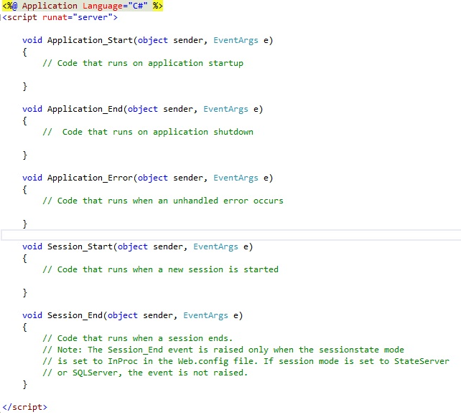
Global.asax File…

Slide 78
Culture (Localization and globalization)
Localization is the process of adapting a software application for a specific locale.
Globalization is the process of identifying the localizable resources of the application.
To support Localization and Globalization, we use
  System.Globalization - can define culture specific information
  System.Resources - ResourceManager Class
  System.Threading namespaces - supports for multithreaded programming
Notes:
Imagine a scenario where we have a web page with a lot of labels and text in it. Without ASP.NET globalization mechanism in place, if I have to render these labels and text based on current locale, then I might end up having a lot of switch cases or if statements. To be precise, one case for each supported language. Now this technique could work but it is time consuming, error prone and sometimes frustrating for the developer.
To avoid having to write such code, ASP.NET provides us Resource files.

Slide 79
Culture (Localization and globalization)…
Has two culture values
  Culture
  UICulture
Culture value is used for date and number formatting
UICulture values are used to determine culture specific resources
Can set culture and UICulture values in the application as follows.
Using <globalization> element of Web.Config.
Using @Page directive in the Page.
e.g.
Thread.CurrentThread.CurrentCulture = CultureInfo.CreateSpecificCulture ("en-GB");
Thread.CurrentThread.CurrentUICulture=new CultureInfo("en-GB");
Notes:
Local resources are the resources which are specific for a page, i.e., there will be local resource file for every page. Global resources and the resources that are common for the whole website, i.e., one resource file that can be accessed by all the pages (there can be multiple global resource files too).

Slide 80
Culture (Localization and globalization)…
Two main properties of Page class have an effect on localization:
  UICulture
    Used to specify which resource files are loaded for the page
  Culture
    Determines how strings such as dates, numerals, and currency amounts are formatted
Setting culture manually
  <%@ Page Language="C#" Culture="bn-BD" UICulture="bn-BD" AutoEventWireup="true" CodeFile="ManualCulture.aspx.cs" Inherits="ManualCulture" %>
  this.lblMsg.Text = DateTime.Today.ToString();
  Setting the Culture in the Web Configuration File
    <globalization culture="en-US" uiCulture="en-US"/>

Slide 81

Culture (Localization and globalization)…
Creating local resource
  <%@ Page Title="" Language="C#" MasterPageFile="~/Site.master" AutoEventWireup="true" CodeFile="LocalizablePage.aspx.cs" UICulture="auto" Inherits="LocalizablePage" %>
  <asp:Button id=”btnSubmit” meta:resourceKey=”btnSubmit” Text=”Click Me!” ToolTip=”Click to show message” OnClick=”btnSubmit_Click” Runat=”server” />
  <asp:Label id=”lblMessage” meta:resourceKey=”lblMessage” Text=”Thank You!” Visible=”false” Runat=”server” /

Slide 82
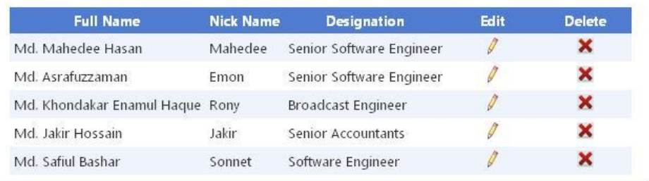
ASP.net Grid view
Powerful server side control
Excellent data binding architecture
Including Sorting, paging, deleting option

Slide 83
IIS
IIS stands for Internet Information Server
IIS is web server application and set of feature extension modules
A Web server is primarily a server application that can be contacted using a bunch of Internet protocols, such as
  HTTP
  File Transfer Protocol (FTP)
  Simple Mail Transfer Protocol (SMTP)
Developed by Microsoft

Slide 84
IIS …
HTTP Request
  When the client request for the resource using HTTP Pipeline.
  Example
    GET /index.html HTTP/1.1
    Host: www.example.com
HTTP Response
  The response from the server against a request
  Example
    HTTP/1.1 200 OK
    Date: Mon, 23 May 2005 22:38:34 GMT
    Server: Apache/1.3.3.7 (Unix) (Red-Hat/Linux)
    Last-Modified: Wed, 08 Jan 2003 23:11:55 GMT
    Content-Type: text/html; charset=UTF-8

Slide 85
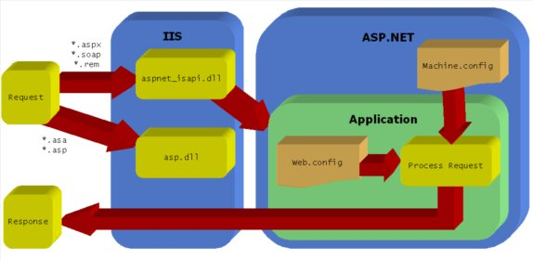
IIS …
Processing server page
Fig – Processing server page

Slide 86
IIS …
Processing server page
  Request is sent by the web browser through the HTTP Protocol.
  The request hits the IIS where the request has the resource location.
  HTTP carries the request in a hyper text format. When IIS gets the request then it checks in the isapi extension to map the worker process.
  Inetinfo.exe at the IIS is responsible for the process. aspnet_isapi.dll is mapped for the asp. net application. Then according to the mapping table if it is an aspx page then aspnet_wp.exe handles the request from asp. net.
  It checks for the resource and after finding the framework executes the assembly and generates the html page for the client.
  IIS then again takes the response from .NET and passes it via HTTP protocol.

Slide 87
IIS …
Application pool
  Concept of application pool is introduced in IIS 6.0
  Application pools are used to separate sets of IIS worker processes
  Application pools used to isolate our web application for better security, reliability, and availability and performance
  Keep running without impacting each other
  Isolation of Different Web Application
  Individual worker process for different web application
  More reliably web application
  Better Performance

Slide 88
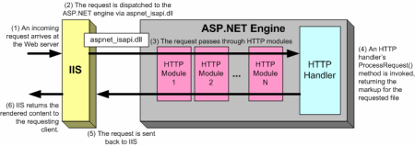
ASP.net Page Lifecycle
Fig – ASP.net page lifecycle
Notes:
This article aims at understanding the role of HTTPHandler and HTTPModule in ASP.NET applications. We will try to work on a basic example to see how these can be implemented.

Slide 89
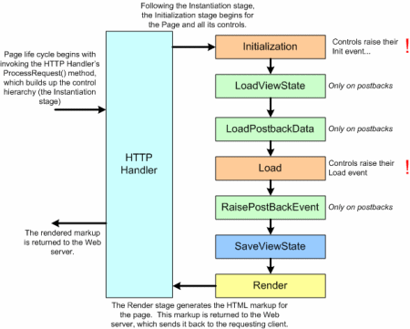
ASP.net Page Lifecycle …
Fig – Events in the page lifecycle

Slide 90
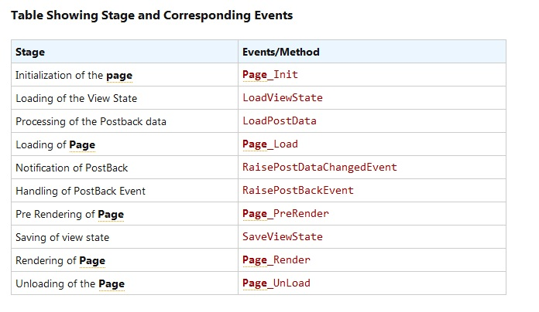
ASP.net Page Lifecycle …

Slide 91
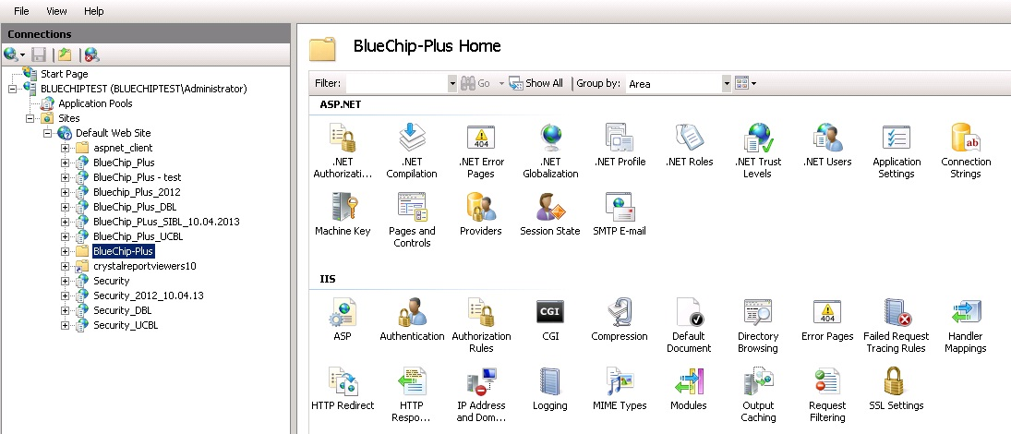
ASP.net Website deployment in IIS

Slide 92
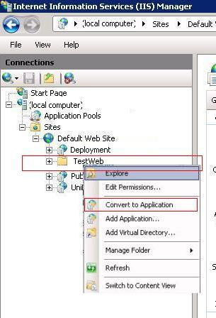
ASP.net Website deployment in IIS …
Convert to Web Application

Slide 93
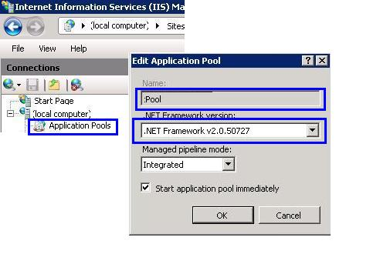
ASP.net Website deployment in IIS …
Create application pool

Slide 94
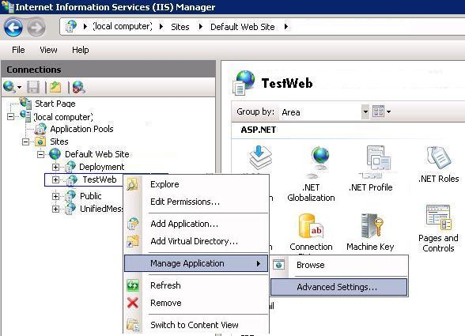
ASP.net Website deployment in IIS …
Assign application pool to the application

Slide 95
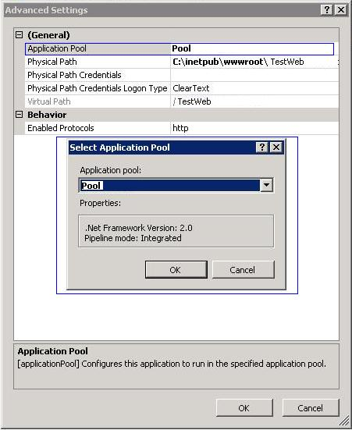
ASP.net Website deployment in IIS …
Assign application pool to the application …

Slide 96


